Slide 1
The Giver By: Lois Lowry
By: Grace Sponseller

Slide 2
Summary
The Giver takes place in a dystopian future where everybody is equal and they never have to experience emotions or make hard decisions. Jonas grew up in this community where nothing is the truth and nothing is experienced in full. As Jonas’ Ceremony of Twelve approaches, he becomes very anxious about what job he will be assigned. Little does he know that he won’t be assigned. Instead, he is Selected to be the new Receiver of Memory and to apprentice with the Giver, as the man calls himself. As he receives more memories from the Giver, he learns the evil truth about the community and decides to run away to find Elsewhere.

Slide 3
Plot Diagram
Jonas is chosen to be the new Receiver of Memory.
Jonas receives memories from the Giver and becomes more aware of what is really going on.
Jonas’ name is skipped over during the Ceremony when he is supposed to be called.
Jonas’ Mother and Father assure him he has nothing to be worried about because he will get a wonderful assignment.
The Giver and Jonas plan to run away to Elsewhere.
Jonas is worrying about the Ceremony of Twelve that will determine what he will do for a job in his community.
Jonas takes Gabriel and runs away from his community to find Elsewhere, a supposedly better place as told to him by the Giver.

Slide 4
Setting & Tone
The setting of The Giver is set in a dystopian future, in what I believe is North America.
The tone of this book is that perfection isn't key to happiness. The author, Lois Lowry, shows this many times throughout the book.

Slide 5
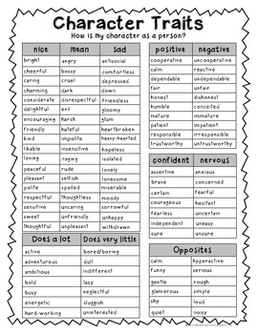
Character Traits, Influences, & POv
Jonas is the new Receiver of Memory. At the beginning of the book, he just believes what the community tells everybody. Throughout the story he becomes more aware of the truth behind his community.
Jonas is influenced by his community because he listens to what the leaders tell him. He is influenced by his friends, Fiona and Asher. Finally, he is influenced by the Giver and the memories he transmits to him.
The Giver is told in a third-person point of view.

Slide 6
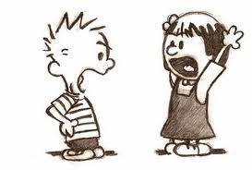
Main conflict
The main conflict in this story is that Jonas struggles with the truth about his community. On page 95 in The Giver, it says, “ ‘We gained control of many things. But we had to let go of others.’ ‘We shouldn’t have!’ Jonas said fiercely.” This shows that Jonas refuses to allow what is happening in his community to be the truth.

Slide 7
Theme #1
The first theme of this story is that something that seems perfect rarely is. On page 151, the book says, “ ‘They brought in the syringe and asked her to roll up her sleeve…..Well, there you are Jonas. You were wondering about release.’” Jonas believes that the Released people were sent to Elsewhere, but they actually get killed.

Slide 8
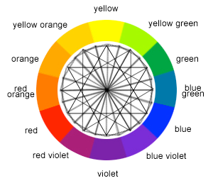
Theme #2
The second theme of this story is that the more you know, the more aware you are of what really happens. In The Giver on page 95, it says, “ ‘Why can’t everyone see them? Why did colors disappear?’ The Giver shrugged. ‘Our people made that choice, the choice to go to Sameness.’” This shows that Jonas is learning more, and therefore, he is more aware of what really happens in his community.

Slide 9
Theme #3
The third theme of The Giver is that there is always a better way, a better place. On page 179, the book says, “For the first time, he heard something that he knew to be music. He heard people singing.” This shows that Jonas think his community is perfect until he learns of Elsewhere and goes there.

Slide 10
Comparisons
The Giver is alike and dis-alike The Hunger Games.
They are both dystopian novels set in the future.
They both have communities/governments that control basically everything.
In The Giver, everyone is well-provided for. In The Hunger Games, it is a struggle to get anything.
In The Giver, everybody is the same and all equal. In The Hunger Games, there are districts that aren’t even close to being equal, going from extreme wealth to extreme poverty.

Slide 11
Most Impactful Signpost
The most impactful signpost in The Giver is on page 128, which I identified as an Aha! Moment. The book says, “ ‘Things could change, Gabe,’ Jonas went on.” Jonas is realizing that things could be different for his community if they didn’t make things the way they were.

Slide 12
Conclusion
The Giver is a novel that shows what could happen in a "perfect" world and what could very easily go wrong. This is an excellent novel that has strong message about what our government should and should not do so that our country won't end up being a dystopian America.

